Slide 1

Crowdfunding
Kickstarter

Slide 2

Total num of projects based on outcome
Purged
178
Suspended
1,501
Live
3,163
Canceled
32,498
Successful
1,04,313
Failed
188293

Slide 3

Crowdfunding Kickstarter Project Analysis
Data Analysis & Visualization in Excel, MySQL, Power Bi and Tableau
Presented by:
Sher Uz Zama Khan
G. Venkata Rama krishna
Revanth
Mohan
Date: 20/02/2025

Slide 4

Introduction
Objective: Analyze crowdfunding campaign performance using Tableau.
Key Questions:
What factors contribute to a successful campaign?
How do backers and funding amounts impact success?
What trends can be observed over time?

Slide 5

Dataset Overview
Data Source: Crowdfunding Kickstarter dataset
Number of Records: 365,893 projects
Key Tables:
Crowdfunding_projects (Main dataset)
Crowdfunding_Location (Geographical data)
Crowdfunding_Creator (Project creators)
Category (Project categories)
Calendar Table (Time-based analysis)

Slide 6
Key Performance Indicators (KPIs)
Overall Success Rate
Total Amount Raised
Total Backers
Average Duration of Projects Days
38.35%
$3,479M
40M
13.42

Slide 7
Analysis - Based on No. of Backers
Most Backed Project: Exploding Kittens (219K backers)
Other Top Projects: Pebble Time, OUYA, Coolest Cooler

Slide 8
Analysis - Based on Amount Raised
Highest Funding: Pebble Time ($20M)
Other High Earners: Coolest Cooler, Pebble 2, Kingdom Death: Monster

Slide 9
Analysis - Goal Ranges & Success Rate
Success Rate by Goal

Slide 10
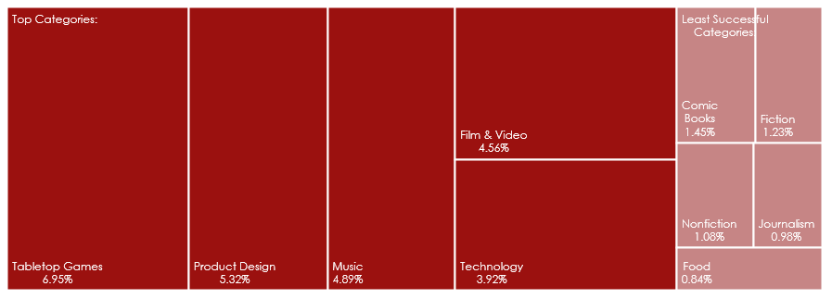
Category-Wise Success Analysis
Top Categories: Tabletop Games (6.95%), Product Design, Music
Least Successful Categories: Comic Books, Fiction, Nonfiction

Slide 11
Success Rate by Year
Peak Success Year: 2017 (13.32%)
Lowest Success Year: 2009 (0.41%)

Slide 12
Success Rate by Quarter
Best Performing Quarter: Q1 (26.68%)
Other Trends: Q2 (25.89%), Q3 (25.44%), Q4 (21.99%)

Slide 13
Success Rate by Month
Highest Success Month: March (9.71%)
Lowest Success Month: December (5.74%)

Slide 14
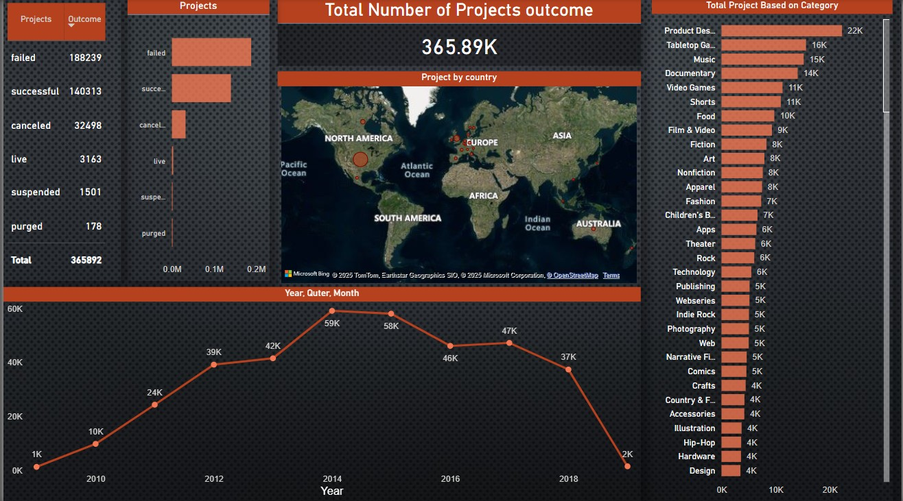

Slide 15
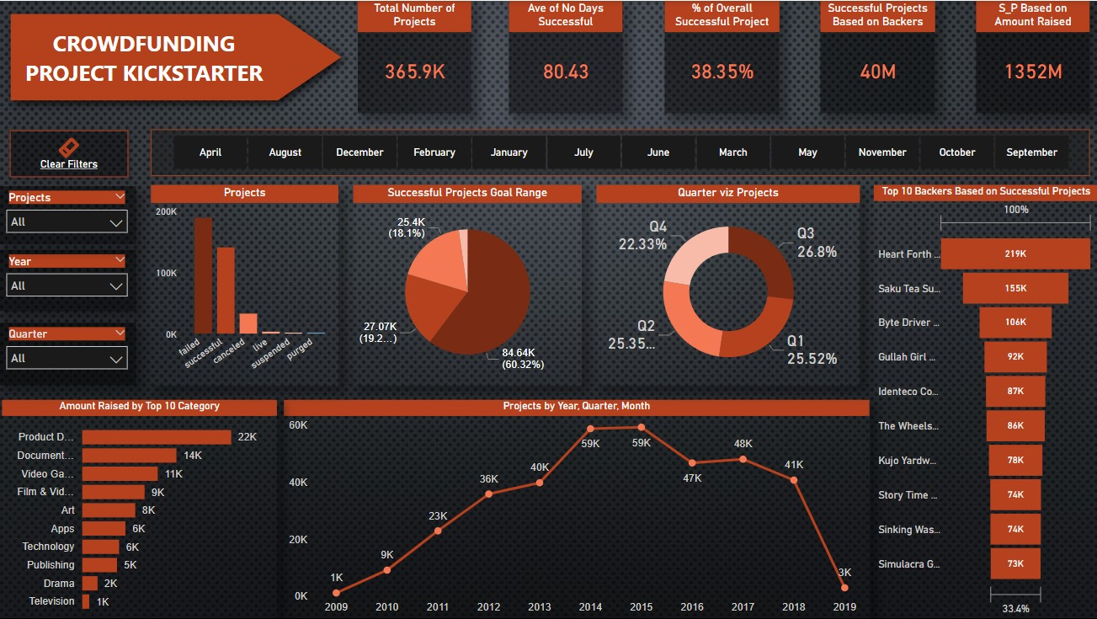

Slide 16
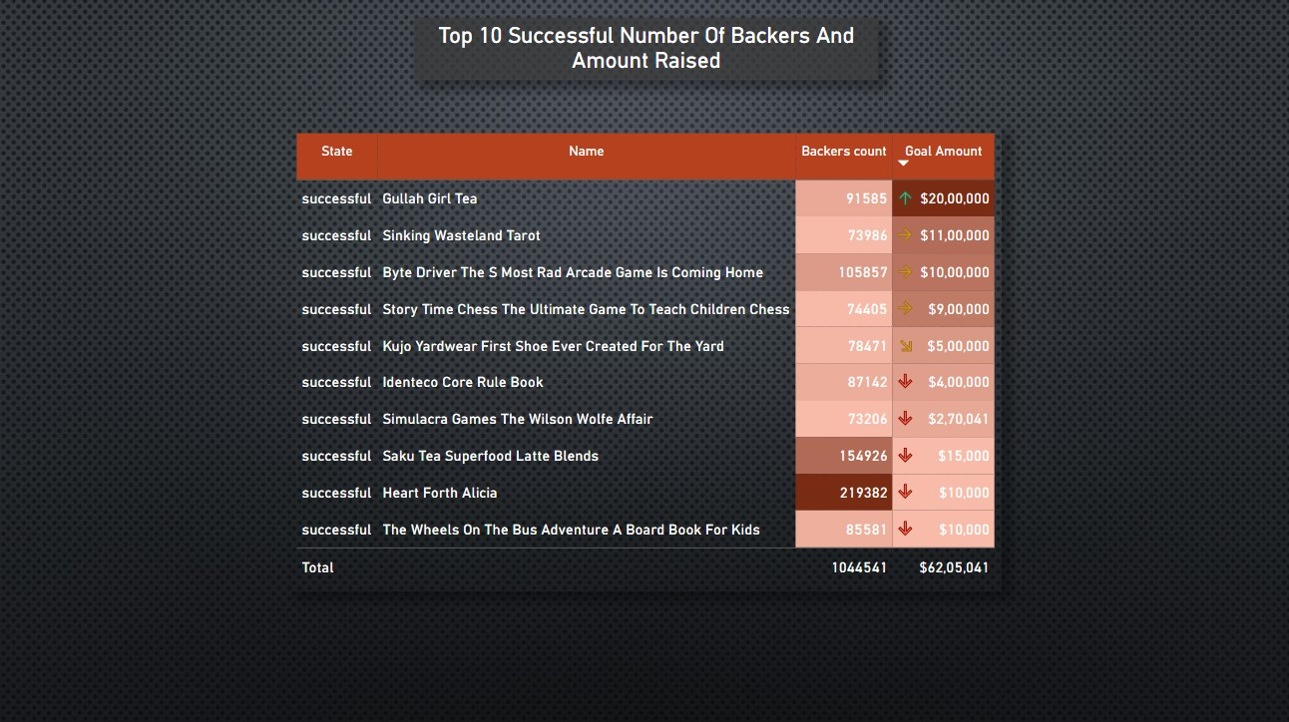

Slide 17
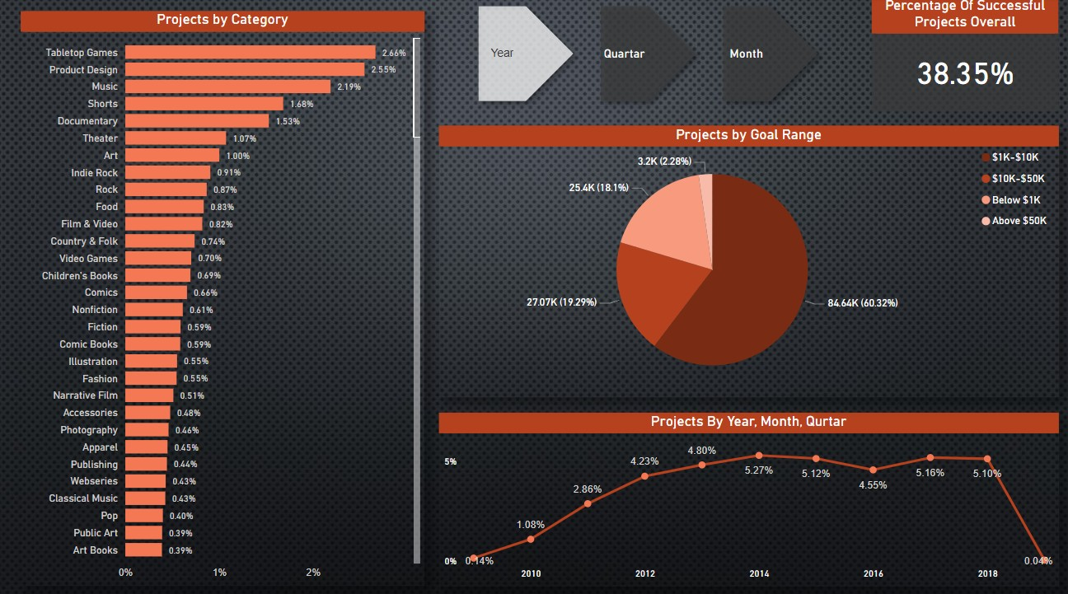

Slide 18
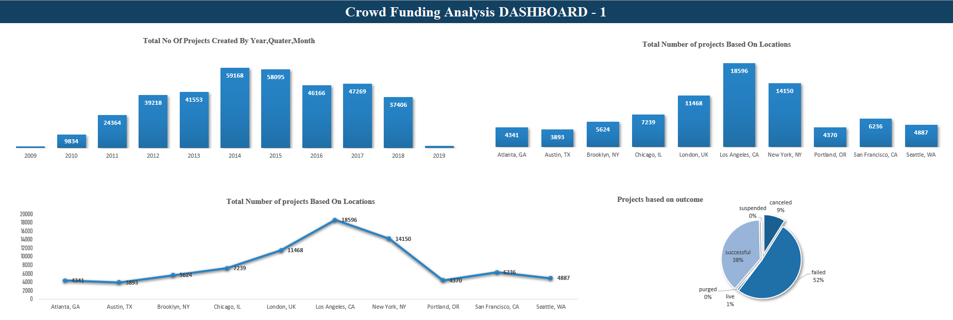

Slide 19
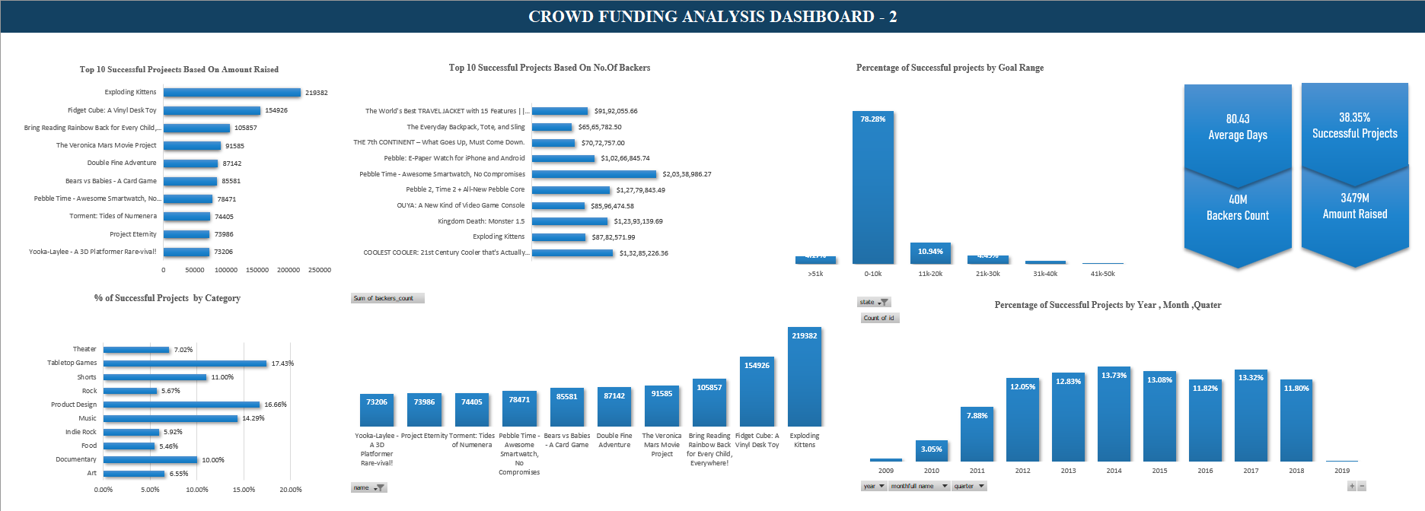

Slide 20
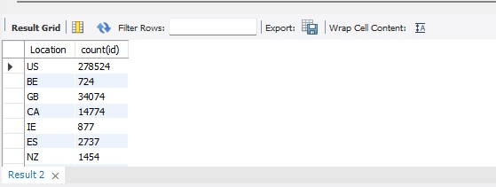
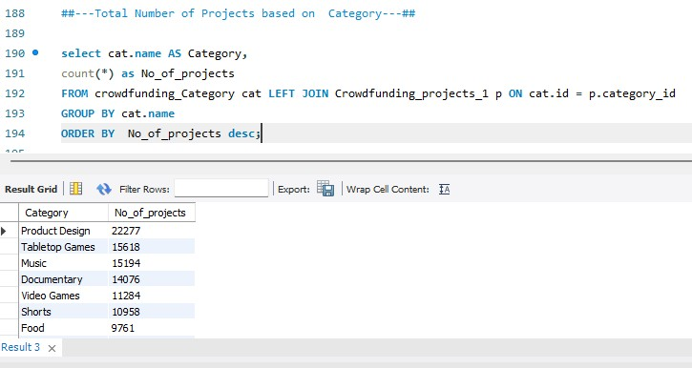
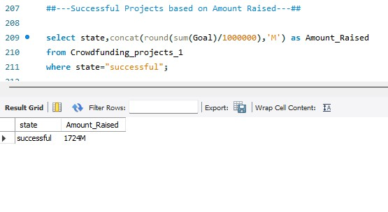
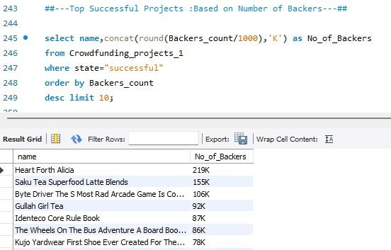
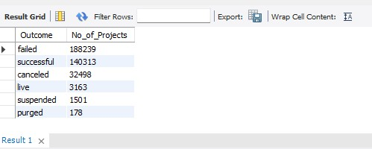

Slide 21
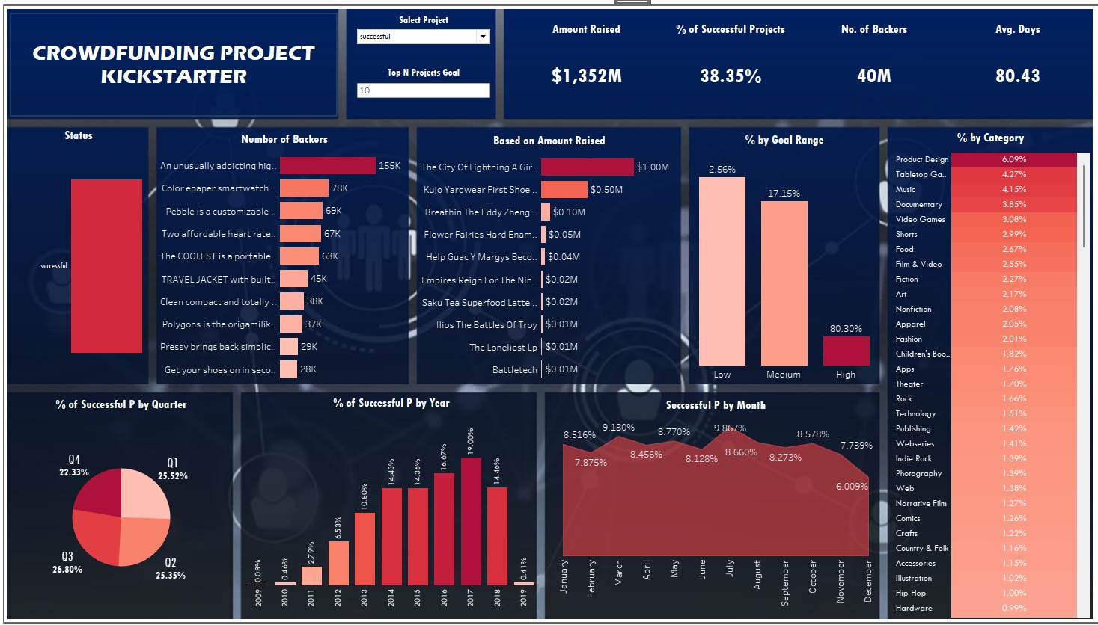

Slide 22
Conclusion & Recommendations
Key Takeaways:
Medium goal projects have the highest success rate.
Certain categories perform significantly better than others.
Timing plays a role in success (Q1 & March are best).
Recommendations:
Optimize goal setting based on historical trends.
Focus on high-performing categories.
Launch campaigns in peak success months.

Slide 23
Q&A
Thank You!
Open for questions and discussions.

